Slide 1

Hospitality Analysis
Group 5,
Priyanka Patil
Adwaitha J H

Slide 2
Summary:
Hospitality refers to extending a welcome to guests or offering a home away from home.
Key Aspects:
Importance of Hospitality:
Customer Experience
Economic Impact
Cultural Exchange
Challenges in Hospitality:
Maintaining high standards.
Adapting Trends
Economic fluctuations
Hospitality is an integral part of the service industry, dedicated to ensuring that guests feel welcomed, comfortable, and valued. It plays a crucial role in driving economic activity, promoting cultural exchange, and enhancing the overall travel and leisure experience.
Accommodation, Food and Beverages,
Travel and Tourism,
Entertainment and Recreation,
Even Management

Slide 3
KPI’s Used
Total Revenue
Occupancy
Cancellation Rate
Total Booking
Utilize capacity
Trend Analysis
Weekday & Weekend Revenue and Booking
Revenue by State & hotel
Class Wise Revenue
Checked out cancel No show
Weekly trend Key trend (Revenue, Total booking, Occupancy)

Slide 4

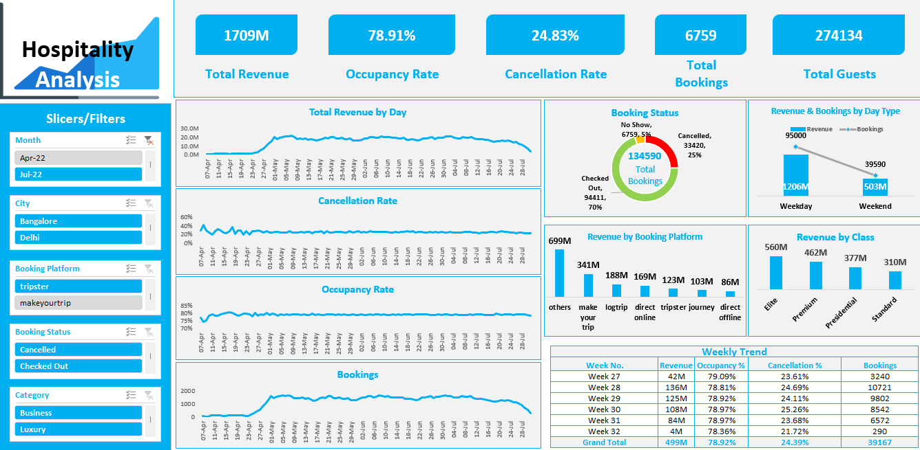
Excel DashboArd

Slide 6

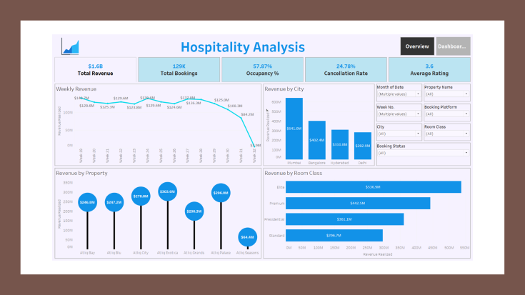
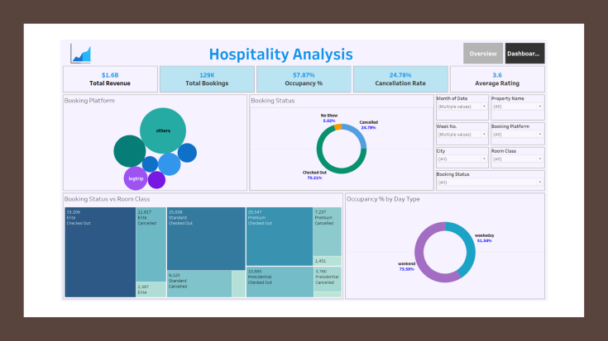
Tableau Dashboard

Slide 7
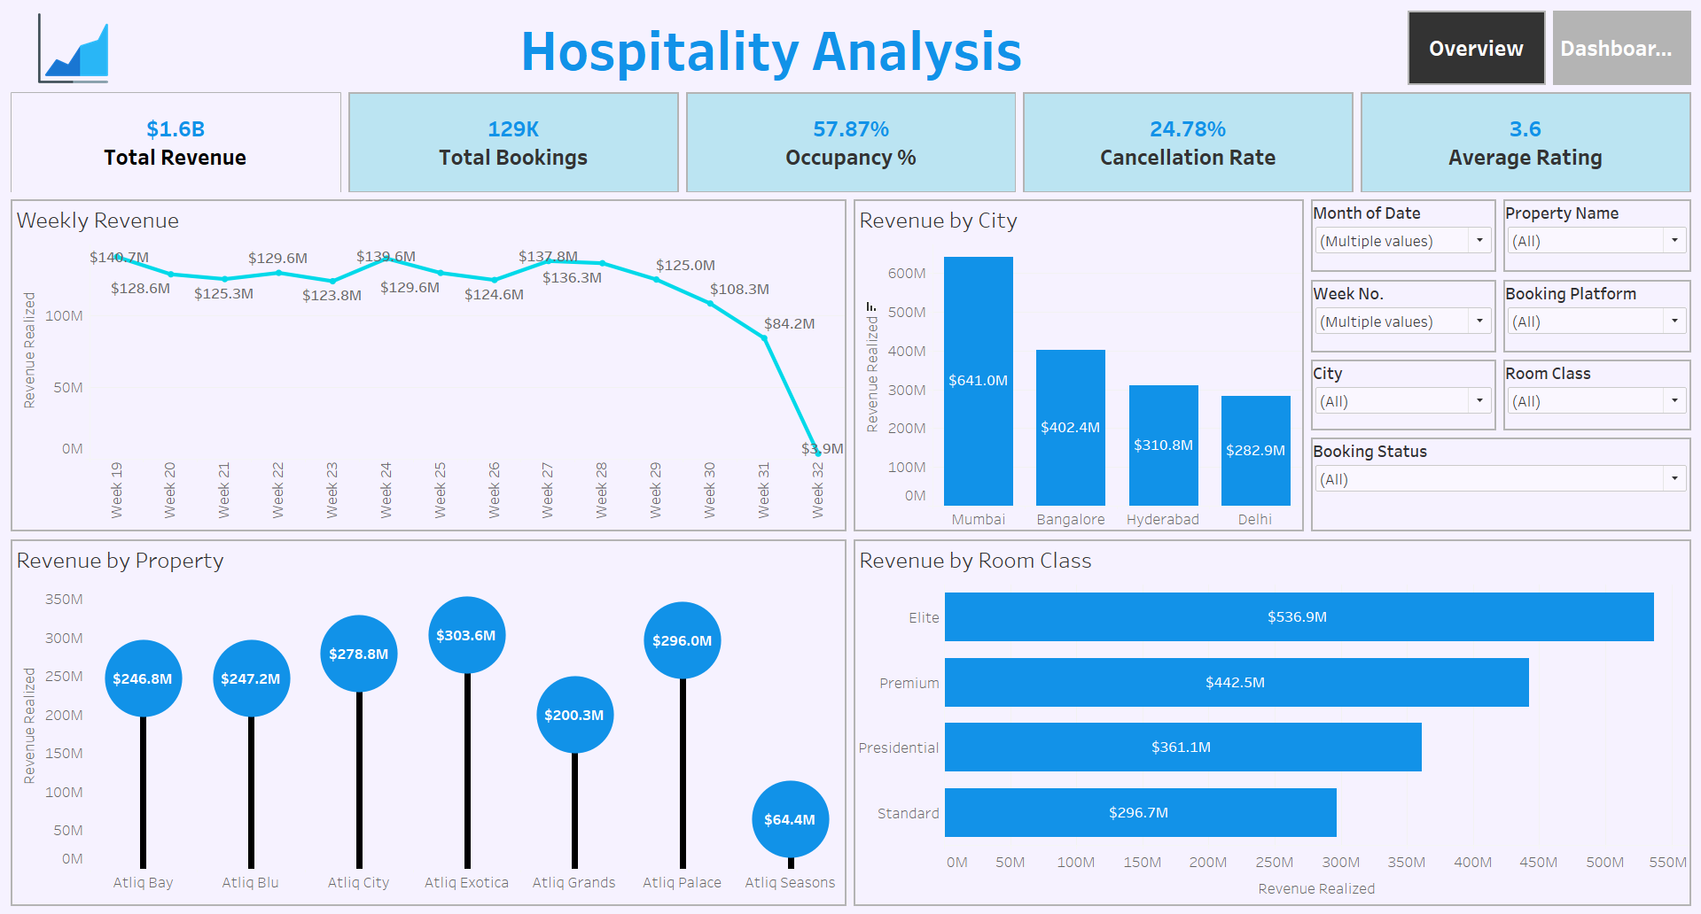

Slide 8
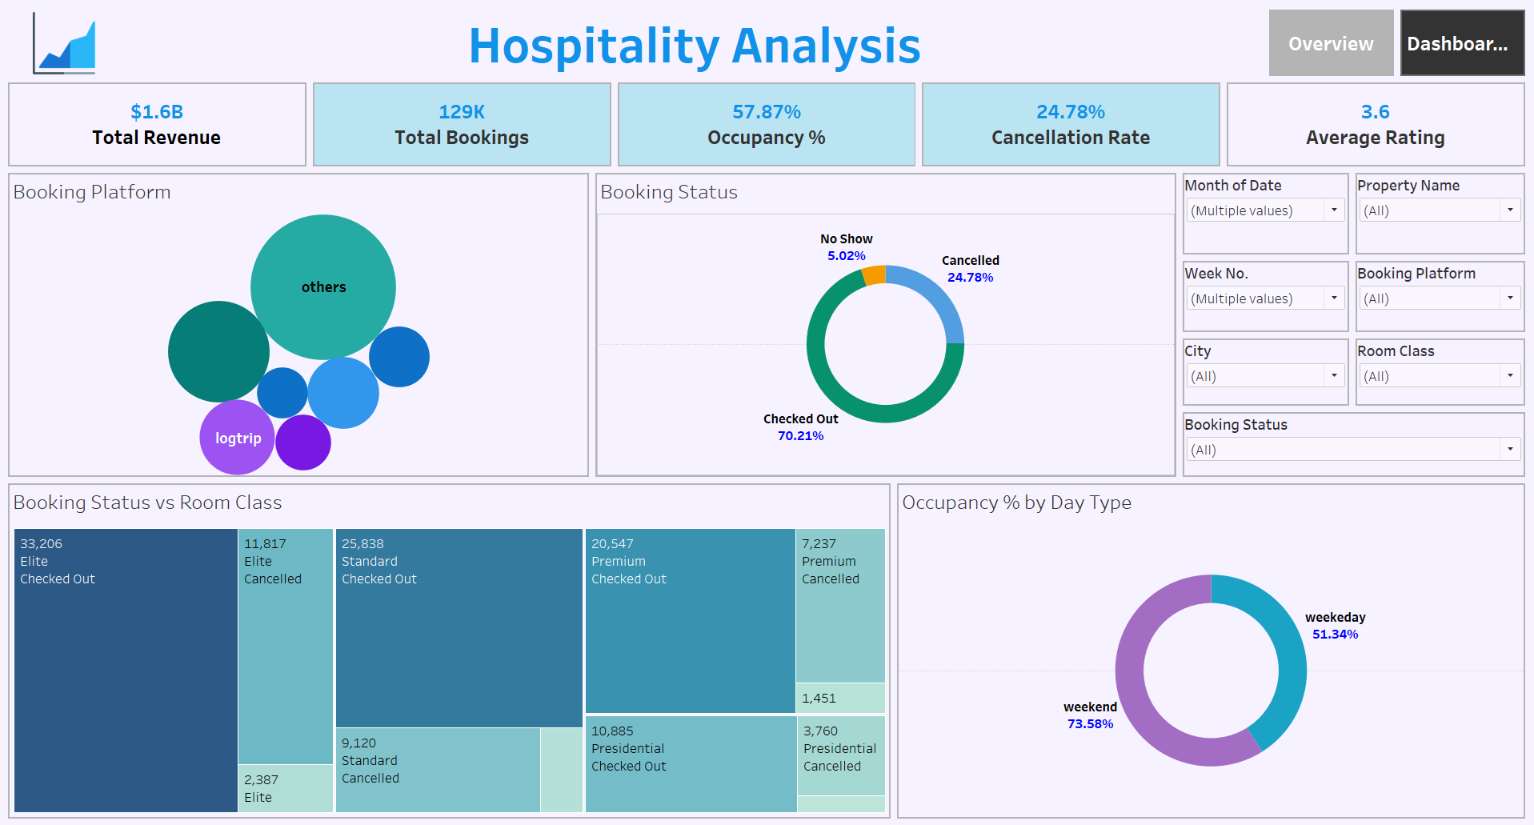

Slide 9


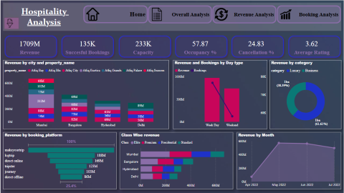
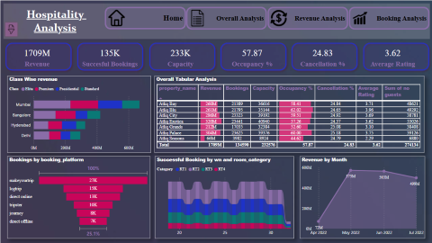
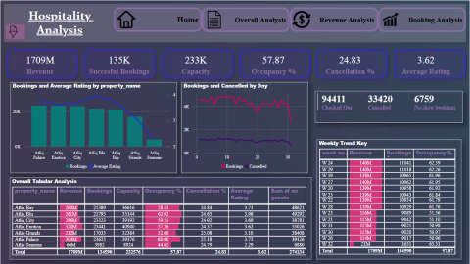
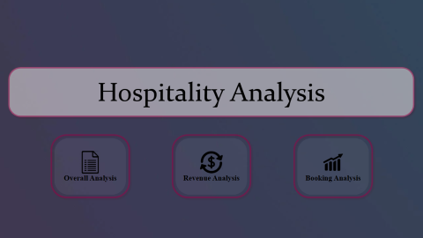
Power Bi Dashboard

Slide 10


Slide 11


Slide 12
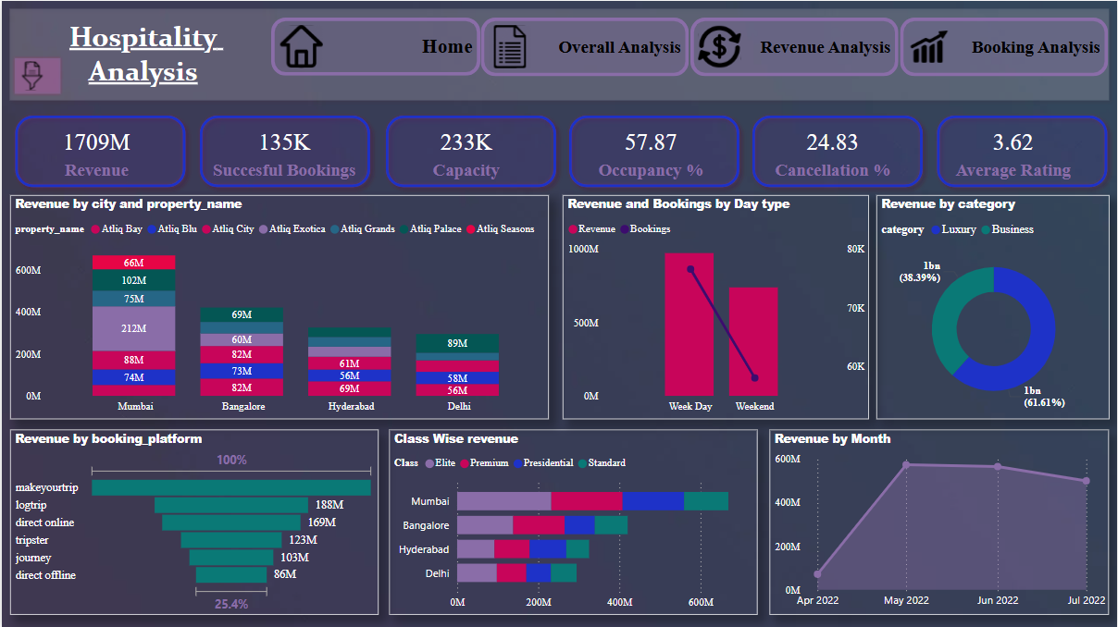

Slide 13
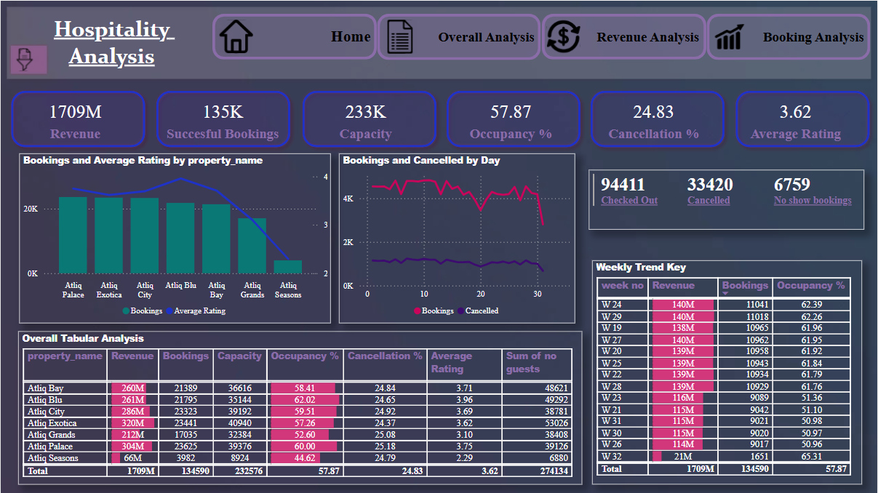

Slide 14
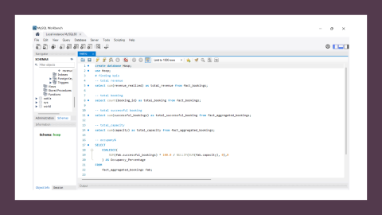
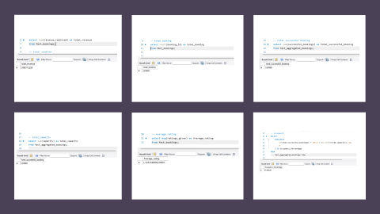
SQL Queries

Slide 15
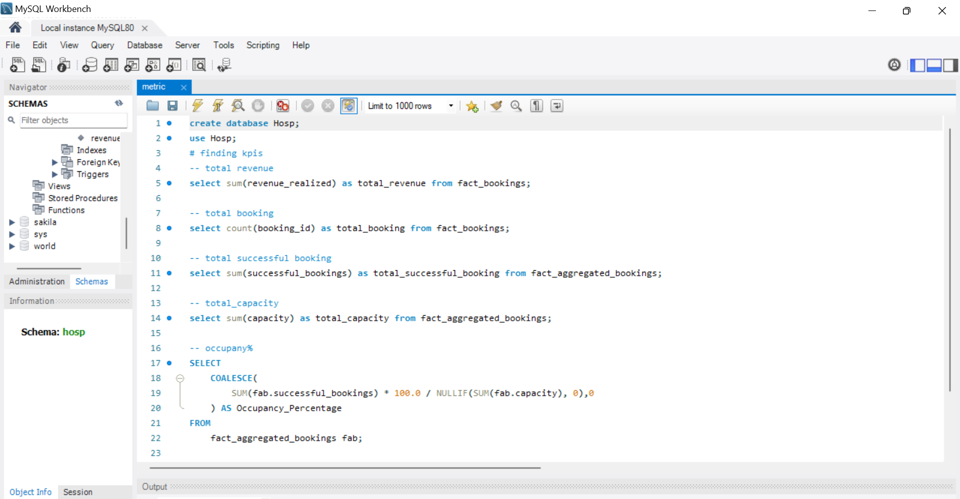

Slide 16
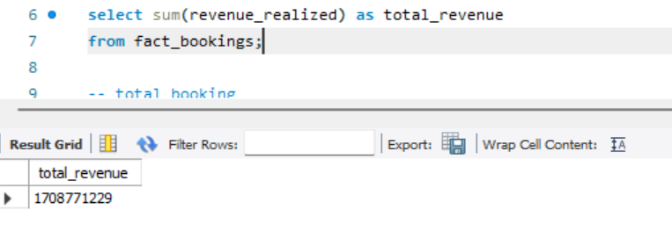
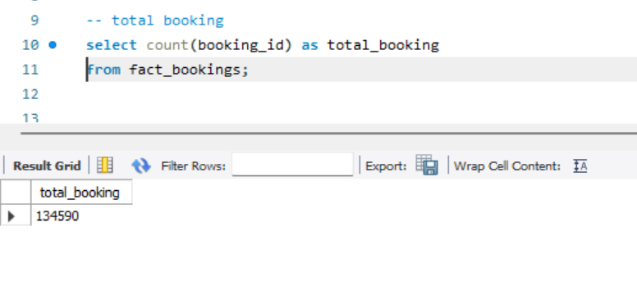
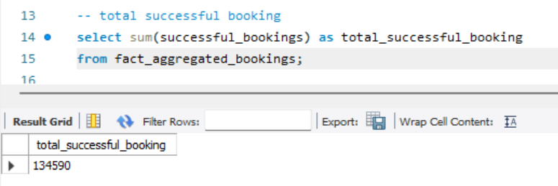
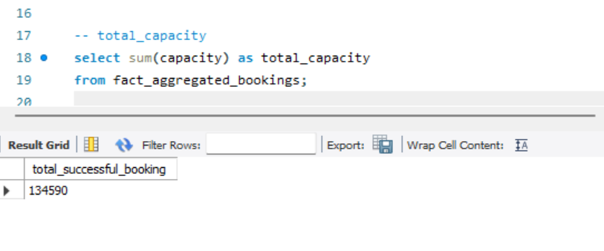
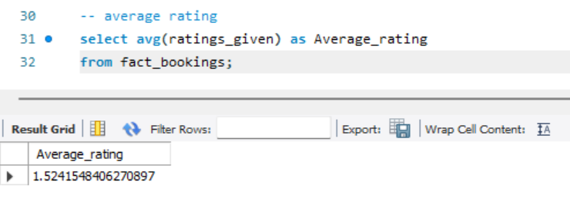
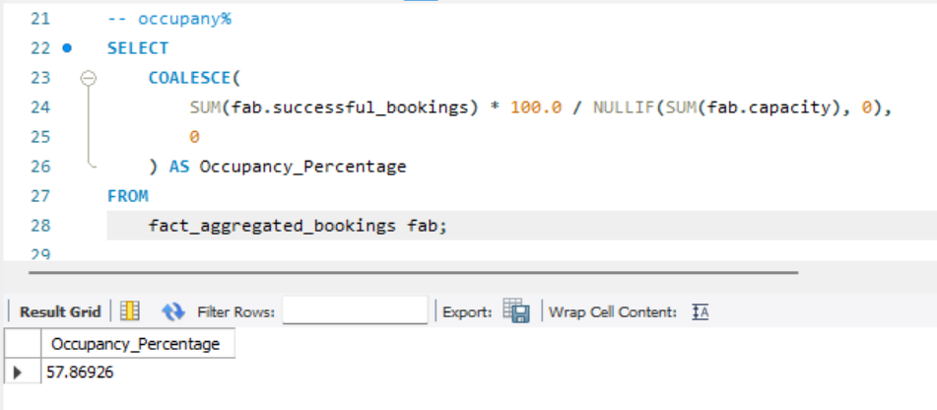

Slide 17

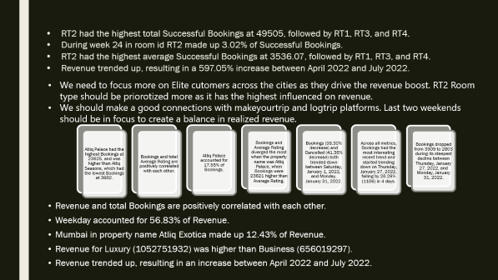
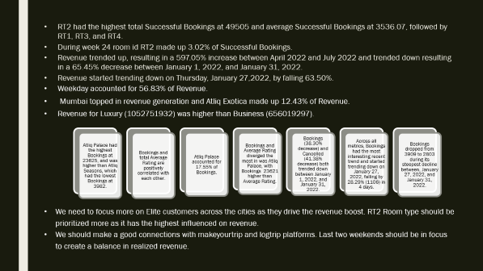
Key Takeaways

Slide 18
RT2 had the highest total Successful Bookings at 49505 and average Successful Bookings at 3536.07, followed by RT1, RT3, and RT4.
During week 24 room id RT2 made up 3.02% of Successful Bookings.
Revenue trended up, resulting in a 597.05% increase between April 2022 and July 2022 and trended down resulting in a 65.45% decrease between January 1, 2022, and January 31, 2022.
Revenue started trending down on Thursday, January 27,2022, by falling 63.50%.
Weekday accounted for 56.83% of Revenue.
Mumbai topped in revenue generation and Atliq Exotica made up 12.43% of Revenue.
Revenue for Luxury (1052751932) was higher than Business (656019297).
Atliq Palace had the highest Bookings at 23625, and was higher than Atliq Seasons, which had the lowest Bookings at 3982.
Bookings and total Average Rating are positively correlated with each other.
Atliq Palace accounted for 17.55% of Bookings.
Bookings and Average Rating diverged the most in was Atliq Palace, with Bookings 23621 higher than Average Rating.
Bookings (38.30% decrease) and Cancelled (41.38% decrease) both trended down between January 1, 2022, and January 31, 2022.
Across all metrics, Bookings had the most interesting recent trend and started trending down on January 27, 2022, falling by 28.29% (1106) in 4 days.
Bookings dropped from 3909 to 2803 during its steepest decline between, January 27, 2022, and January 31, 2022.
We need to focus more on Elite customers across the cities as they drive the revenue boost. RT2 Room type should be prioritized more as it has the highest influenced on revenue.
We should make a good connections with makeyourtrip and logtrip platforms. Last two weekends should be in focus to create a balance in realized revenue.

Slide 19

Thank you

